Slide 1
Welcome back to Economics Club!
11/11 Introductory Meeting
Notes:
Serene

Slide 2
Agenda
01
02
03
Meetings
What do we do?
NEC
04
05
06
Points
Lesson
Kahoot!
Notes:
Faith

Slide 3
Meeting Dates
2nd and 4th Friday of each month
After school in Ms. Zengel’s room (4-215)
Typical Meeting Outline
Updates
Lesson
Fun Activity
Snacks! :)
Notes:
Mira

Slide 4
What do we do?
Lessons
Competitions
Activities
Bi-weekly lessons on different economics topics!
Group activities
Games
Kahoots
Jeopardy
NEC activities
National Economics Challenge (main competition)
Potentially others!
Notes:
Faith

Slide 5
National Economics Challenge
A national economics competition for high-schoolers
2 divisions:
Adam Smith
David Ricardo
Teams of 3-5 students
3 rounds:
State (March - May): at school
National Semi-Finals (May): at school
National Finals (May): somewhere different every year (i.e. NYC)
Start thinking about who you want on your team!
Notes:
Hannah

Slide 6
Membership Points System
Active membership - 15 pts (subject to change)
1 point per general meeting
5 points for NEC
1 point for 1 t-shirt design
2 points for 2+ t-shirt designs
Notes:
Mira

Slide 7
Become a Member
There are NO DUES!!!
T-shirts will be a separate cost if you wish to get one later
Scan the QR code to apply!
Notes:
Mira

Slide 8
T-shirts
Front & back design
1 t-shirt design = 1 membership point
2+ t-shirt designs = 2 membership points
Must be a white design (to go on a maroon or navy shirt)
If possible, please submit this as a transparent background image, if not that’s okay though!
Econ/club-related
Submit them to phueconomics@gmail.com with your name in the email as well, thank you!
Notes:
Faith

Slide 9
What is Supply?
Supply is the different quantities of goods that sellers (suppliers) are able to sell (produce) at different prices.
Quantity Supplied is the specific quantity of a good that producers are willing to sell at a certain price at a certain point in time.
What is the Law of Supply?
There is a DIRECT relationship between price and quantity supplied.
Notes:
Serene

Slide 10
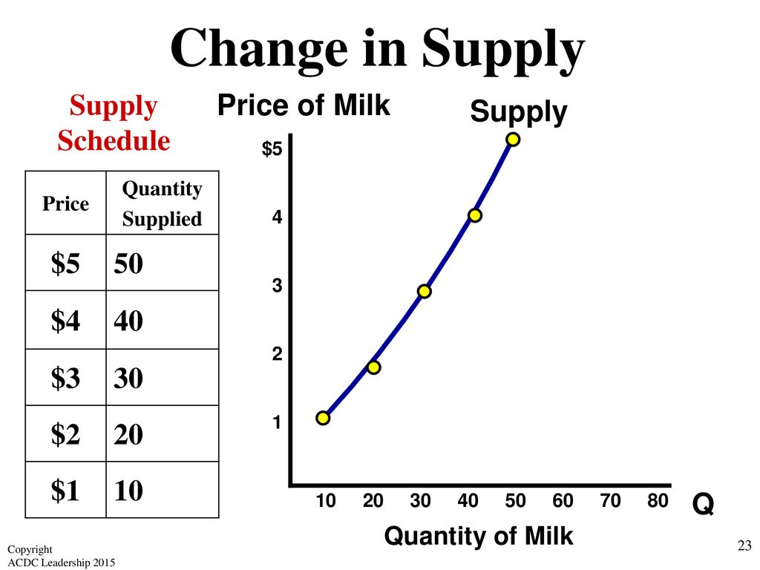
Graphing Supply
A supply curve is a graphical representation of a supply schedule
The supply curve is upward sloping, showing the direct relationship between price (y-axis) and quantity supplied (x-axis)
When looking at the supply curve, we assume all other factors are constant, or ceteris paribus
Notes:
Serene

Slide 11
Shifters of Supply
Resource (availability/cost)
Other goods’ price
Taxes, subsidies, gov. regulation
Technology (productivity)
Expectations of the producer
Number of firms in the industry
Remember the acronym ROTTEN!
Notes:
Serene

Slide 12
What is Demand?
The quantity of a good or service that consumers are willing and able to buy at given prices during a period of time.
Example: You are able to purchase canned beans, but you aren’t willing to buy them then you do not demand them.
Quantity Demanded is the specific amount of a good or service that people are willing to buy at a particular price at a particular point in time.
What is the Law of Demand?
There is an INVERSE relationship between price and quantity demanded.
Notes:
Hannah

Slide 13
Why does the Law of Demand Occur?
The Substitution Effect
If the price goes up for a product, consumers purchase less of that product and substitute it with another product.
Pizza Hut vs. Domino’s
The Income Effect
If a product’s price decreases, the consumers’ purchasing power increases, allowing them to purchase more.
3. Law of Diminishing Marginal Utility
Utility = Satisfaction
The more you buy of ANY GOOD the less satisfaction you get from each new unit consumed.
Therefore, consumers are only willing to buy more, if the price falls.
Notes:
Hannah

Slide 14
Shifters of Demand
Tastes/preferences
Related goods/services
Income
Buyers (number of them)
Expectations of price
Remember the acronym TRIBE!
Notes:
Hannah

Slide 15
Bingo!
Good luck! :)
Notes:
Serene

Slide 16
Contact Information
Email: phueconomics@gmail.com
Website: phuhseconomics.weebly.com/
Remind: @phuecon
Instagram: @phueconomics

Slide 17
Questions?!?!
Ask Away!!!
Notes:
Serene

Slide 18
Thank You!
Next Meeting on 12/9 (2nd Friday)!!
Notes:
Serene

